Slide 1
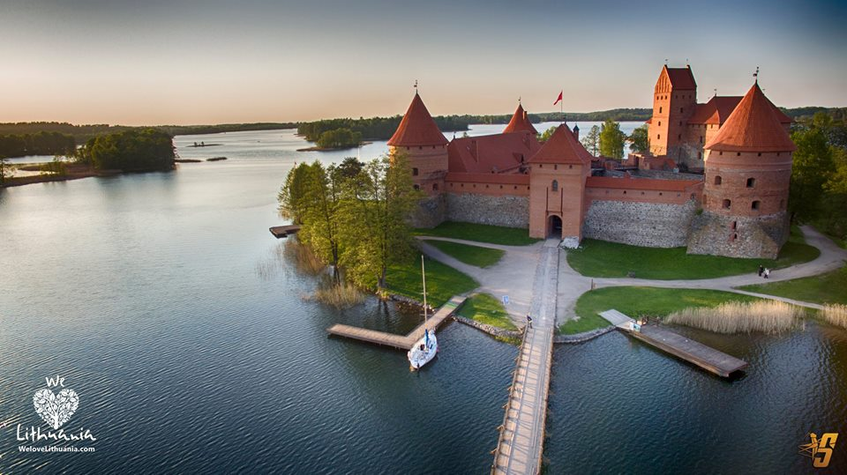
Lithuania
LITHUANIA

Slide 2
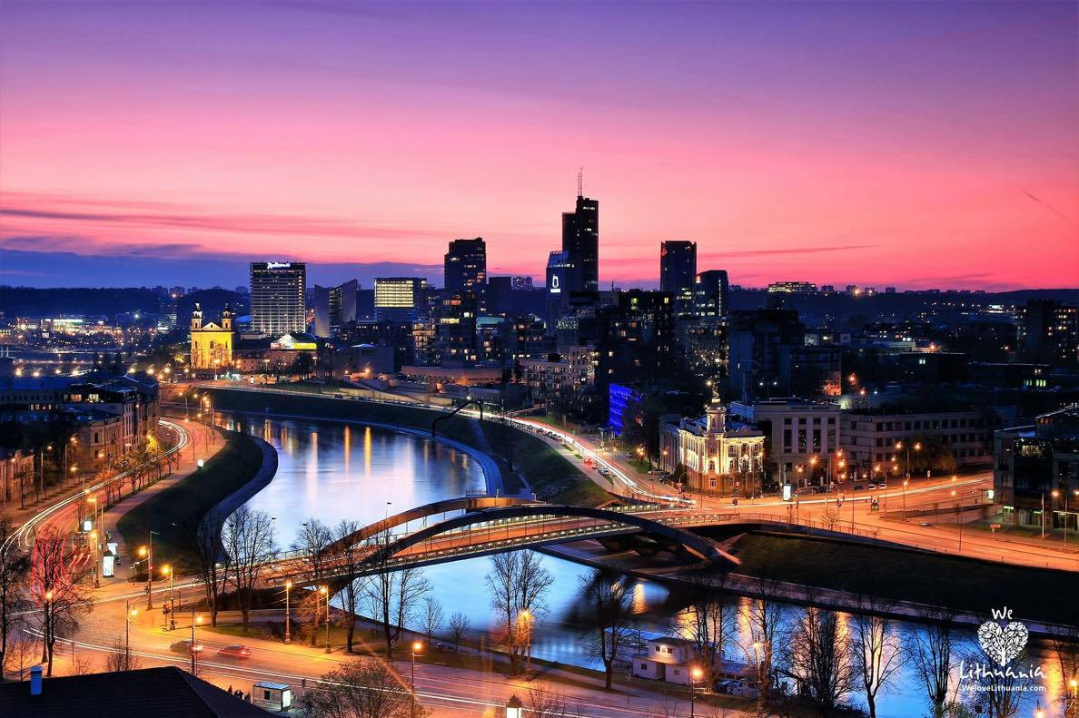
This world was given by fate to me
Greyish sky, snowy castles and horizons
In the autumn, red maples paint it red
And it welcomes everyone

Slide 3
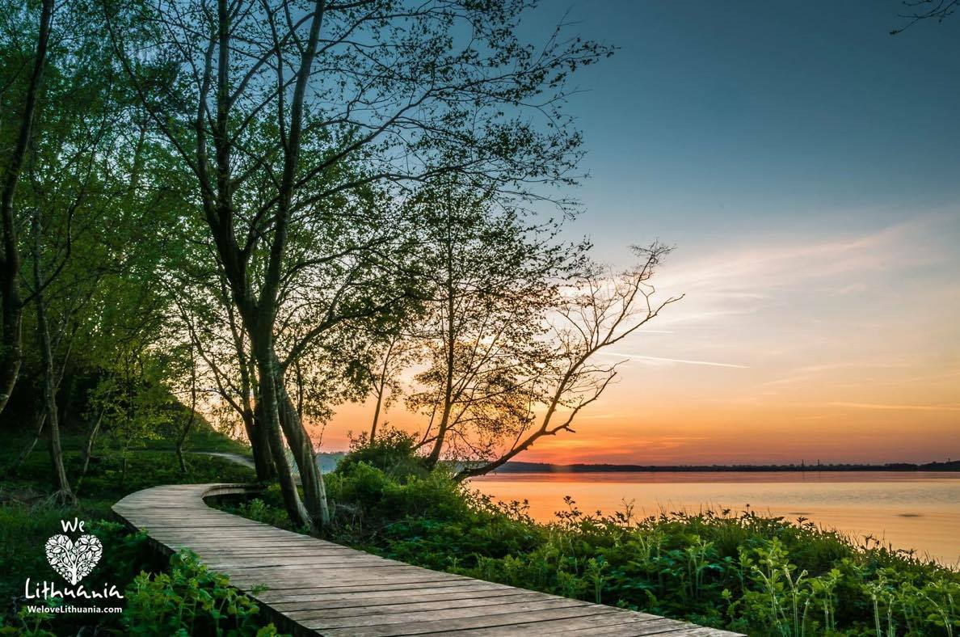
I love it the way it is
Its nature cast a spell upon me
And I wish all problems would go away
This world is the only home for me

Slide 4
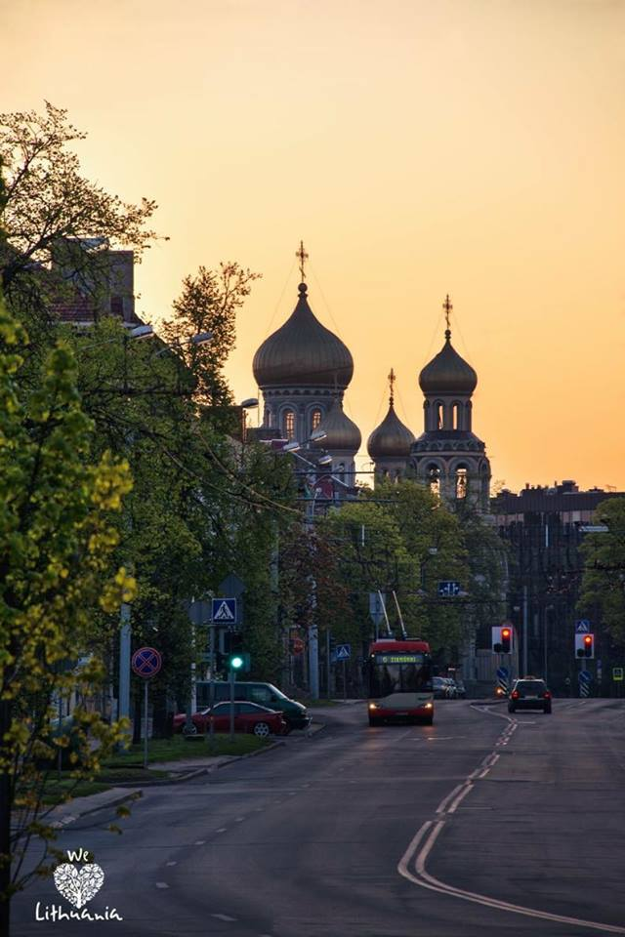
It is the only meaning in my
life and nobody’s going to change it
For it I gave up everything
It’s the beginning and it is the end

Slide 5
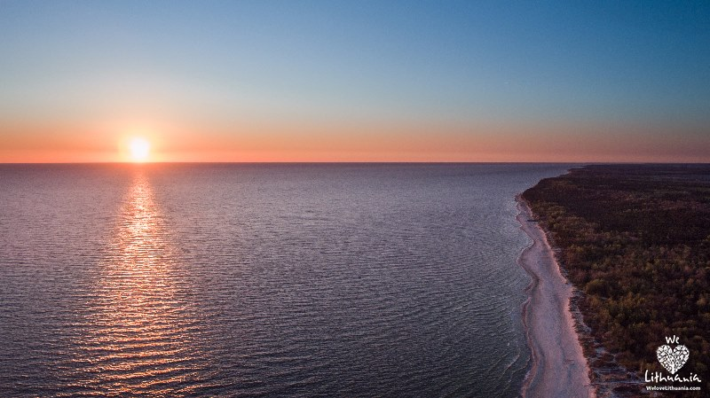
If you are not around on whom I can rely on?
How can I appreciate the sunshine again?
Where should I search for you? How
can I save you?
How can I save you from disappearing from my life?

Slide 6
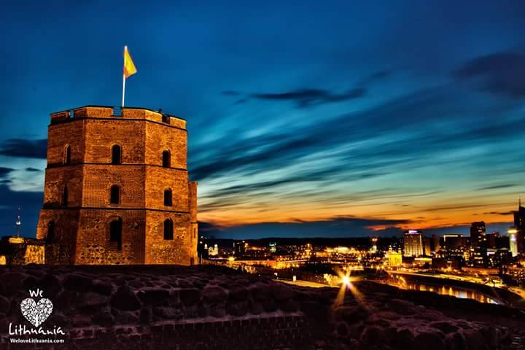
It is the only meaning in my life and
nobody’s going to change it
For it I gave up everything
It’s the beginning and it is the end

Slide 7
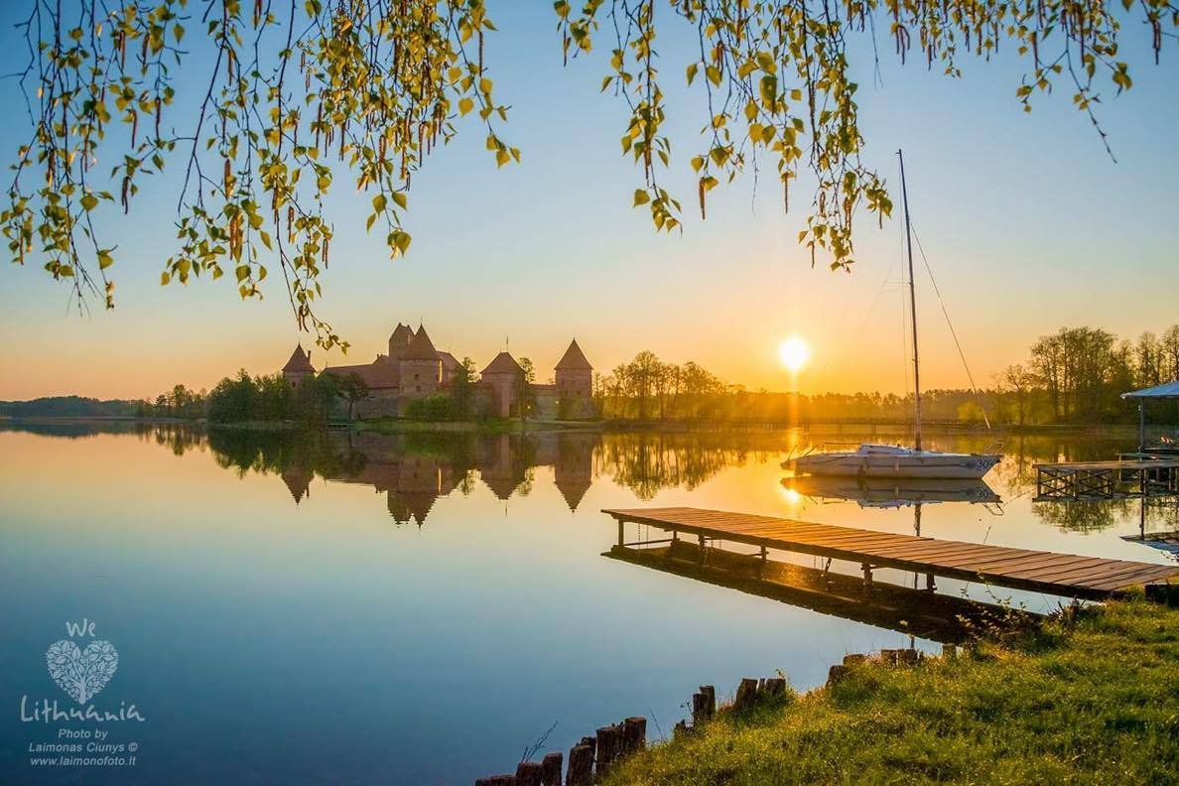
Our mutual pain - I will never forget
But I know, that trees will blossom soon again
Someday I will turn back to dust
When my world will invite me back again

Slide 8
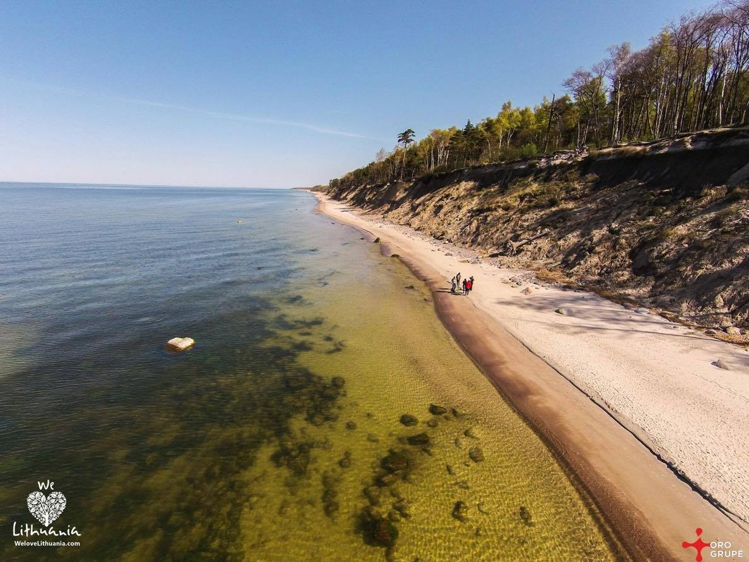
It is the only meaning in my
life and nobody’s going to change it
For it I gave up everything
It’s the beginning and it is the end

Slide 9
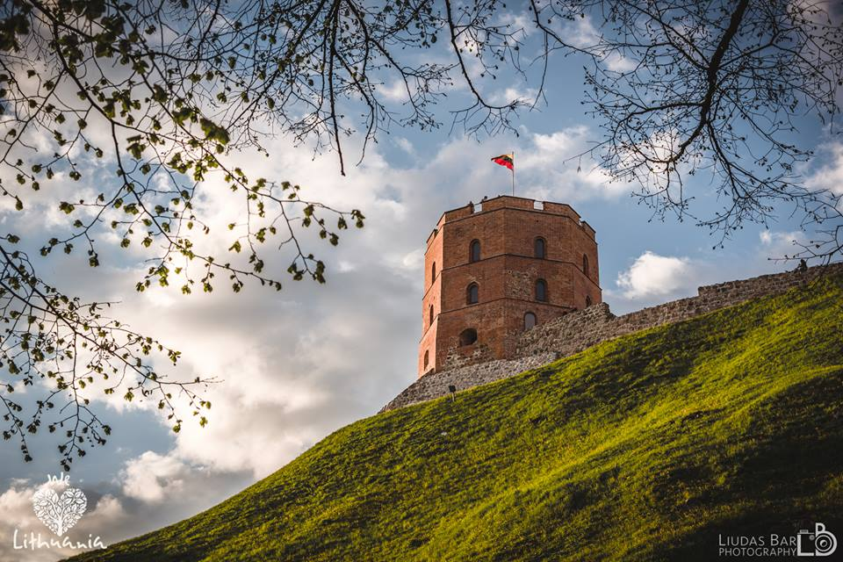
It is the only meaning in my life and nobody’s going to change it
It’s the beginning and it is the end
For it I gave up everything
It’s the beginning and it is the end

